Slide 1
CIS 276: Introduction to Enterprise Web Development
Exercise 2
Exercise 3
Custom.txt
ex3 folder
fruit.txt

Slide 2
Learning Outcomes
This presentation will...
Review standard file structure
Explore HTML lists
Configure a web page using HTML5 header, nav, main, and footer elements
Introduce the div element
Use the anchor element to link files
Create absolute, relative, and e-mail hyperlinks
Code, save, and display a web page document

Slide 3
File Structure
Every project should have the following file structure:
A folder with the project name
An images folder in the project folder
A pages folder in the project folder
A styles folder in the project folder
An index.html file in your project folder

Slide 4
HTML Lists
Ordered List
Unordered List
Description List formerly called a definition list

Slide 5
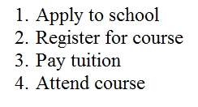
Ordered List
Displays a numbering or lettering system to itemize the information contained in the list. Can also include attributes for additional features
<ol> Contains the ordered list
<li> Contains an item in the list
</li>
</ol>

Slide 6
Ordered List: Attributes
Attributes are included in the opening tag. There are four possible: type, start, reversed, and compact.
type is deprecated, but supported by HTML 5
1 Numbered list (default) ◦ A Uppercase letters
I Uppercase Roman numerals ◦ a Lowercase letters
i Lowercase Roman numerals
start is deprecated, but supported by HTML 5
Specifies start value
reversed is NEW to HTML 5
Specifies that the list order should be descending
compact is not supported in HTML 5
Specifies that list should be rendered smaller than normal

Slide 7
Ordered List: Example
Notice that the attribute is included in the opening tag.
<ol type="a"; reversed>
<li>Apply to school</li>
<li>Register for course</li>
<li>Pay tuition</li>
<li>Attend course</li>
</ol>
Remember that a numbered list is default; changed by attribute
d. Apply to school
c. Register for course
b. Pay tuition
a. Attend course

Slide 8
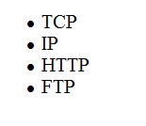
Unordered List
Displays a bullet, or list marker, before each list entry.
Attributes compact and type are NOT supported in HTML 5
"type" specified the kind of marker to use in the list (square, circle [open], disc [solid circle]) Now in CSS.
<ul> Contains the unordered list
<li> Contains an item in the list

Slide 9
Unordered List: Example
<ul>
<li>TCP</li>
<li>IP</li>
<li>HTTP</li>
<li>FTP</li>
</ul>

Slide 10
Description List
Useful to display a list of terms and descriptions or a list of FAQ and answers (no attributes).
<dl> Contains the description list
<dt> Contains a term/phrase/sentence Configures empty space above and below the text
<dd> Contains a description of the term/phrase/sentence
Indents the text
Configures empty space above and below the text

Slide 11
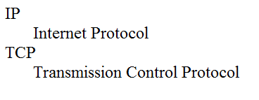
Description List: Example
<dl>
<dt>IP</dt>
<dd>Internet Protocol</dd>
<dt>TCP</dt>
<dd>Transmission Control Protocol</dd>
</dl>

Slide 12
Nested Lists
Since only list type and list items (one level) are part of the element, must nest lists to display multiple levels (indented items)
Each level of nesting is indented by the browser and given a different marker.
Too many levels could push the text to the right edge of the browser document window or beyond, forcing your viewer to scroll horizontally.
In your source code, indent sections of the list to make it easier to read.
Remember that white space in the source code is ignored by the browser; the tags cause the list to be indented on the Web page.

Slide 13
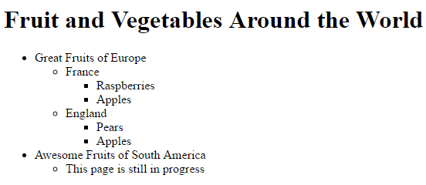
Your Turn!
Create the following using an h1 level for the heading and nested unordered lists (with list items) for the remainder.
Start with astructure.html and save as fruit.html.
Open fruit.txt and copy/paste it into the body of fruit.html.

Slide 14
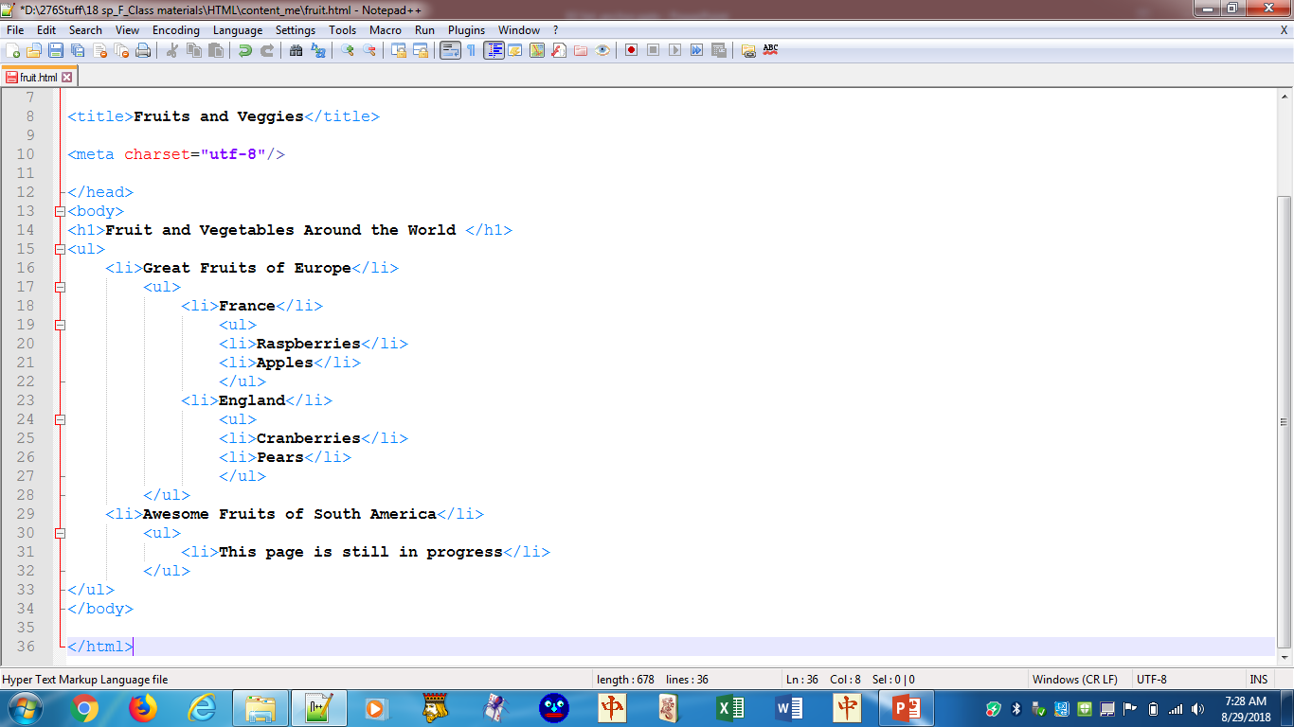
When we get to CSS, the placement of the </li> for "Great …" WILL make a difference (when we discuss descendant and child selectors).
The alternative solution is shown on the next slide.

Slide 15
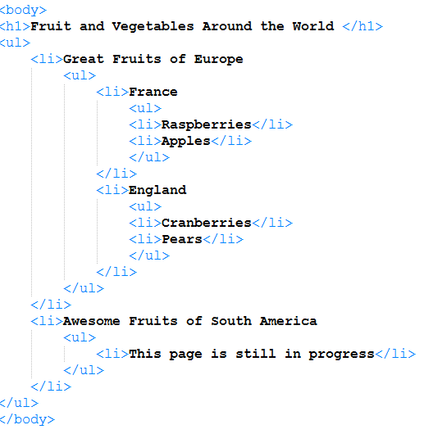
Note where <li>s close in this vs the previous example.
Note where <li>s close in this vs the previous example.
Note where <li>s close in this vs the previous example.

Slide 16
Your turn! Exercise 2
Locate Exercise2.docx (instructions) in your files. I suggest that you open it and size it to fit half of the monitor, vertically, and use the other half for your HTML work.
You begin with the text file Custom.txt, which you save as custom.html.
Follow the remainder of the instructions in the Word doc for Exercise 2a, 2b, and 2c.

Slide 17
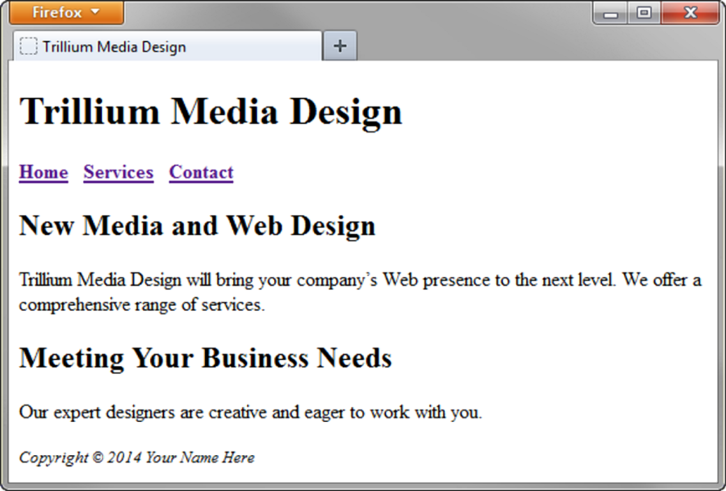
HTML5 Structural Elements
Header
Nav
Main
*
*
*
*
Footer
body
Notes:
Header element is to contain the headings of either a web page document or an area within the document such as a section or article (discussed later).. Element is block display and usually contains one or more heading level elements (h1 - h6).
Nav element contains the navigation links.
Main element is to contain the main content of a page. There should be only one main element per web page.
Footer is to contain the footer content of a page or section

Slide 18
Div Element
Configures a structural block area or “division” on a web page with empty space above and below.
Can contain other block display elements, including other div elements
<div>
<h3>Home Services</h3>
<ul>
<li>general repairs</li>
<li>yard work</li>
</ul>
</div>

Slide 19
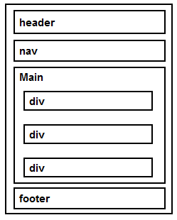
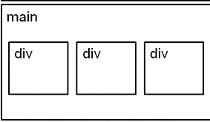
HTML5 Structural Elements
<body>
<header> document headings here </header>
<nav> main navigation here
</nav>
<main> main content here
<div>content</div>
<div>content</div>
<div>content</div>
</main>
<footer> document footer info </footer>
</body>
CSS could render:
Notes:
Div is a block element (extends from left to right side of container element) with space above and below. Using CSS, we can change to inline style.

Slide 20
Anchor Element
Specifies a hyperlink reference (href) to a file
Text between the <a> and </a> is displayed on the web page
href Attribute
Indicates the file name or URL
<a href="filename.html">Contact Us</a>
<a href="http://url">Read More</a>

Slide 21
Absolute Hyperlinks
Absolute link
Link to a different website
The href value to the site's home page includes the http:// protocol and the domain name.
<a href="http://yahoo.com">Yahoo</a>
The href value to a page other than the home page must include a specific folder name and could include a file name.
<a href="http://www.usi.edu/business/computer-science/">CS at USI</a>

Slide 22

Relative Hyperlinks
Relative link
Link to pages on your own site (relative to the location of the current file)
<a href=“alum.html">Alumni</a>
See line 72 of USI’s code
Note use of some elements you should recognize (ul, li, a, href, etc.).
Also note adherence to standard indenting protocols

Slide 23
File Structure
Structure:
Project Folder (Name will vary depending upon project)
Images folder
Contains all of the images used in the web site
Pages folder
Contains all of the pages used in the web site
Styles folder
Contains all of the CSS files used in the web site
Index.html file
The file a browser will use to initialize the web site
The first page displayed on the browser

Slide 24
Relative Locations
Directory View:
Site Map View:
LR project
index.html
project
images
grn-room.jpg
pages
reserve.html
rooms
images
pages
styles
blueroom.html
redroom.html
greenroom.html
styles
rooms
lr_styles.css

Slide 25
Relative Locations
Path starts at the location of the file containing the anchor tag
Path Name Start Significance
href="redroom.html" blueroom The file redroom.html is in the
current folder (rooms).
href="rooms/redroom.html" reserve The file redroom.html is in a
folder named rooms, which is in
the current folder (pages).
I.
LR project
index.html
i.
ii.
images
grn-room.jpg
A..
Outline markers added for emphasis
.
iii.
pages
reserve.html
A..
B.
rooms
blueroom.html
a
redroom.html
b
greenroom.html
c
iv
styles
lr_styles.css
A..

Slide 26
Relative Locations
Path starts at the location of the file containing the anchor tag
Path Name Start Significance
href="../reserve.html" redroom The file reserve.html is in a folder (pages) that is one level above the
current folder (rooms).
href="../../index.html" blueroom The file index.html is in a
folder (LRproject) that is two levels above the current folder (rooms).
I.
LR project
index.html
i.
ii.
images
What is the path from greenroom to the jpg?
grn-room.jpg
A..
.
iii.
pages
"../../images/grn-room.jpg"
reserve.html
A..
B.
rooms
blueroom.html
a
redroom.html
To display the image in greenroom…
b
greenroom.html
c
<img src="../../images/grn-room.jpg" />
iv
styles
lr_styles.css
A..

Slide 27
E-Mail Hyperlink
Automatically launches the visitor's default mail program configured for their browser with you as the recipient
If no browser default is configured, a message is displayed
Uses mailto instead of http://
<a href="mailto:me@gmail.com">me@gmail.com</a>

Slide 28
Additional Notes
1. EVERY project should have a project folder. Within the project folder there should be 3 folders--images, pages, styles--as well as an index.html file for the home page.
2. Recall that the anchor tag and href attribute <a href…> designate a link from where the tag resides to another location. Since your files are all in a project folder, when the project folder is copied to another location (like BB), the relative path between files remains within the folder. Therefore, DO NOT include a drive letter in the path.
3. Folder names, file names, image names, etc. should have NO SPACES and preferably should be in lower case letters.
4. Your first assignment is HTML only and should not include ANY formatting--not inline and not CSS. Remember that the inline formatting shown to you is legacy and informational, but not to be used in new web pages.

Slide 29
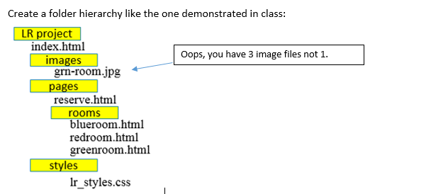
Your turn! Exercise 3
Locate Exercise3.wpd (instructions) in your files. It begins as shown below. Follow the remainder of the instructions in the Word doc for Exercise3a and 3b.
The files to be placed in the various folders have been provided in your zipped files on BB and should be copy/pasted into your hierarchy.

